Slide 1
Web Sessions: Managing State in Web Applications
System Design Fundamentals - Web Concepts

Slide 2
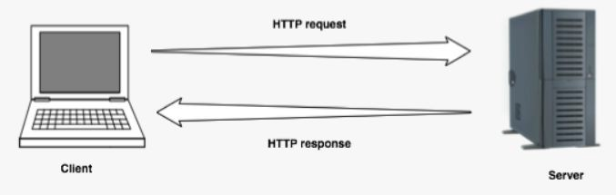
Why Web Sessions Matter?
Web applications often need to track user state (e.g., login status, shopping cart, user preferences)
HTTP is stateless, meaning each request is independent
Goal: Understand how to maintain state in web applications

Slide 3
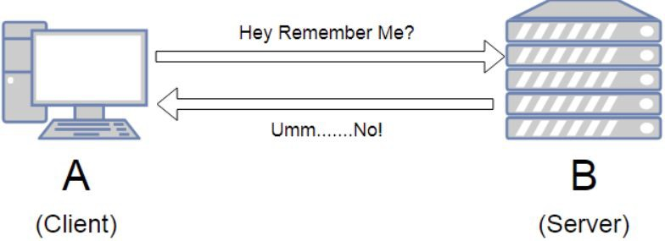
Understanding Statelessness in HTTP
HTTP does not retain memory of previous requests
Each request must contain all necessary information
Why this is a challenge for user sessions

Slide 4
Techniques for Maintaining State
Session-Based Authentication (Server-side session storage + Cookies for session IDs)
  The server maintains session state.
  The client holds only a session ID (usually in a cookie).
Token-Based Authentication (JWTs, OAuth Tokens)
  The session state is embedded within the token itself.
  The server does not need to track user sessions.

Slide 5
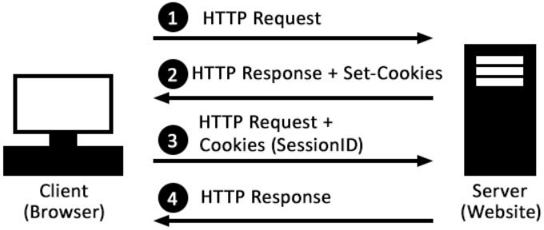
Session-Based Authentication
Server-side session storage
Cookies for session IDs
User logs in → Server creates a session & assigns a session ID
Session data is stored server-side, while session ID is sent to the client
The client stores the session Id in the cookie

Slide 6
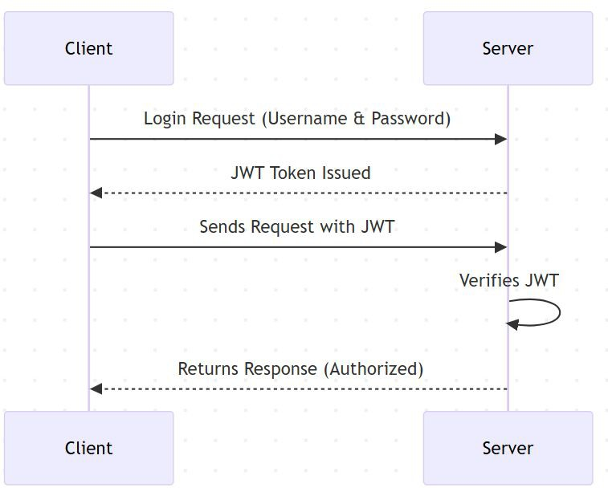
Token-Based Authentication
Encodes session data in a self-contained token
No need for server-side session storage
Used in modern stateless authentication (e.g., OAuth, API tokens)

Slide 7
Security Concerns in Session Management
Session Hijacking: Stolen session IDs
Cross-Site Request Forgery (CSRF): Unauthorized actions
Secure Cookie Handling: Avoiding theft via Secure, HttpOnly, and SameSite ﬂags

Slide 8
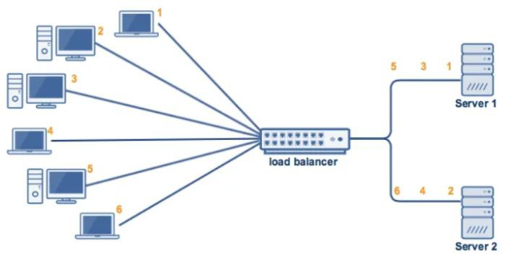
Best Practices for Scaling Session Management
Sticky Sessions vs. Distributed Sessions
Storing session data in Redis, Memcached
Stateless authentication (JWTs) for scalability

Slide 9

Important Interview Questions on Web Sessions
Understanding Statelessness & State Management
  Why is HTTP considered a stateless protocol?
  How do web applications maintain state despite HTTP being stateless?
Session Management Techniques
What are the diﬀerences between server-side sessions and client-side tokens?
When would you use JWT-based authentication instead of session-based authentication? How do cookies and sessions work together in session-based authentication?
Security & Best Practices
What is session hijacking, and how can it be prevented?
How does CSRF exploit session management, and what are the mitigation strategies? Why should cookies be set with Secure, HttpOnly, and SameSite attributes?
How can session management be scaled in distributed systems?
Real-World Scenarios & System Design
  How does a load-balanced system handle session storage?
  In a microservices architecture, how do you manage authentication across multiple services?
  How do large-scale applications like Facebook, Amazon, or Google handle user sessions eﬃciently?
●
○
○
○
●
○
○
○
○
●

Slide 10
Summary & Key Takeaways
HTTP is stateless, requiring session management techniques
Cookies, server-side sessions, JWTs are common methods
Security risks like session hijacking and CSRF must be mitigated
Scaling sessions requires distributed storage solutions
What’s next:
  Serialization: Data Exchange & Storage Formats

